Slide 1

Movie Recommendation System
Created using Python, Streamlit, and Machine Learning

Slide 2

Project Overview
Objective:
This project aims to develop a content-based movie recommendation system that suggests movies similar to the one provided by the user.
Motivation:
With the vast number of movies available across various platforms, users often struggle to choose what to watch next.
Approach:
We use a content-based filtering approach, comparing movie features to provide relevant recommendations.

Slide 3
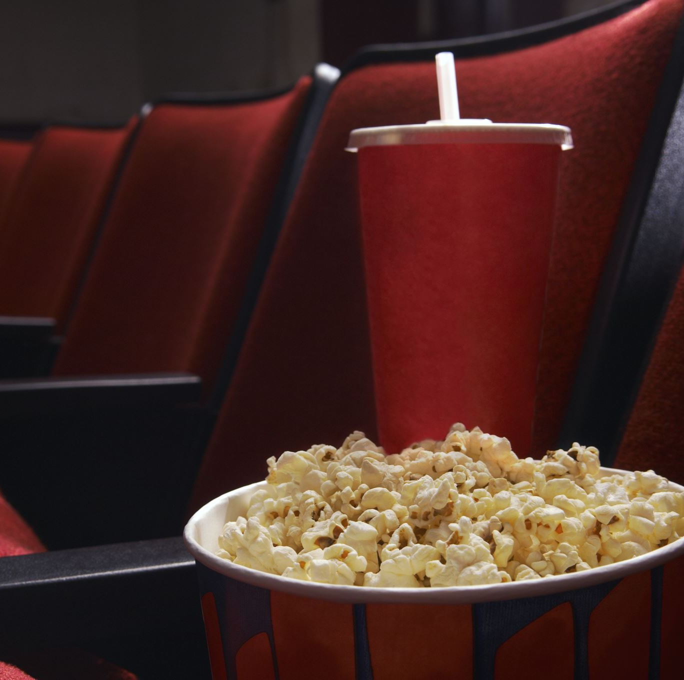
Data Loading and Preprocessing
Datasets Used:
• 'tmdb_5000_credits.csv' for cast and crew details.
• 'tmdb_5000_movies.csv' for movie details such as genres, budget, revenue.
Data Cleaning:
• Handling missing or null values by filling them with empty strings.
Merging Data:
• Credits and movies data were merged for comprehensive movie details.

Slide 4
Feature Selection
Selected Features:
• Genres (e.g., Action, Drama).
• Keywords (key themes of the movie).
• Tagline (marketing slogan or summary).
• Cast (main actors in the movie).
These features represent the core elements of the movie’s content.

Slide 5
TF-IDF Vectorization
TF-IDF (Term Frequency-Inverse Document Frequency):
• Evaluates the relevance of a word in a document relative to a corpus.
• It highlights words important to a document but less frequent across the dataset.
In this system, we vectorize movie features using the TfidfVectorizer and calculate feature importance.

Slide 6
Cosine Similarity for Recommendation
Cosine Similarity:
• Measures similarity between two movies by calculating the cosine of the angle between their feature vectors.
• A score of 1 means they are identical, 0 means dissimilar.
This method compares the orientation of movie features and ranks similar movies based on the similarity scores.

Slide 7

Streamlit Web Interface
Streamlit is a Python framework for creating interactive web applications.
The recommendation system uses Streamlit to enable users to input a movie title and receive real-time movie suggestions based on similarity scores.
• User Input: Enter movie title.
• System Output: List of recommended movies.

Slide 8

Conclusion and Future Work
Key Takeaways:
• This content-based system suggests movies based on their features and similarity to the user’s input.
Future Enhancements:
• Incorporate collaborative filtering for user-based recommendations.
• Apply deep learning models for improved feature extraction.
• Develop a hybrid recommendation system by combining content-based and collaborative filtering.

